Slide 1
HIV Counseling &Testing

Slide 2
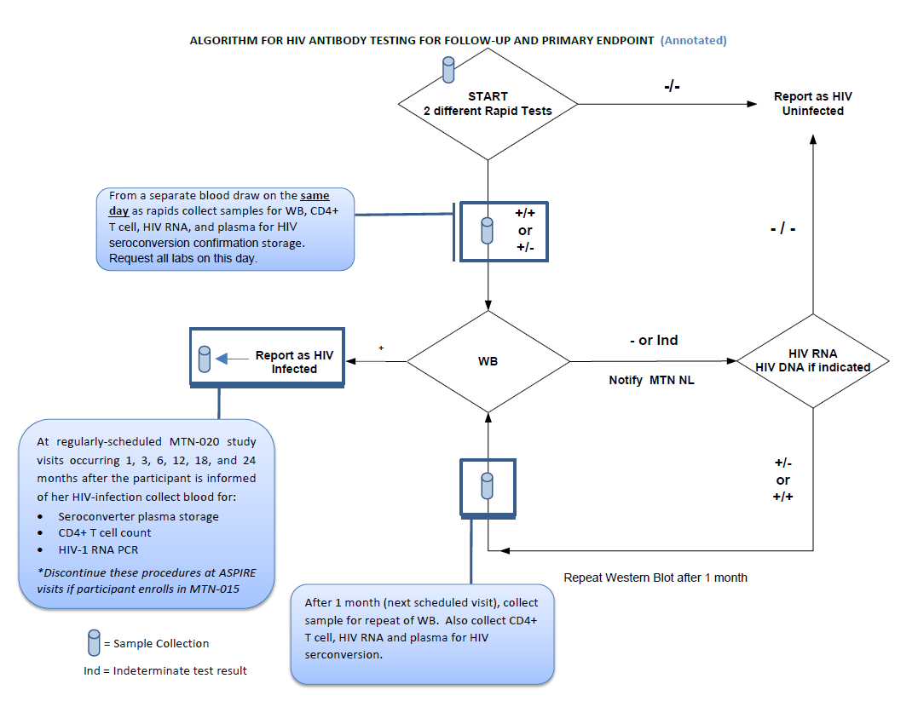
Page 346
Notes:
Walk through of an annotated HIV algorithm at follow up. This focuses on the blood draws that are needed.

Slide 3
HIV and Risk Reduction (RR) Counseling
Required at all scheduled visits
Includes HIV Pre- and Post-test counseling
Client-Centered approach
Notes:
Can note HIV counseling will be covered in detail on Day 4 with counselors.
First Bullet – highlight need to avoid rote repetition
Second – think about as a site, will this be the same counselor, or different. If different, how to ensure consistency of session? How can documentation support this consistency?
Third: prompt group – what does the term “client centered” mean to you? Some possible responses/characteristics to highlight:
Personalized/Tailored
Non-judgmental
Mutually respectful
Responsive to current participant needs (for information, education, support, motivation, skills-building, and/or referrals.)
Incremental (may need to set smaller goals over time)
Participant-driven (participant identifies barriers/challenges/facilitators – counselor role is to support/facilitate development of strategies/goals to overcome)
Supported/Facilitated by the counselor

Slide 4
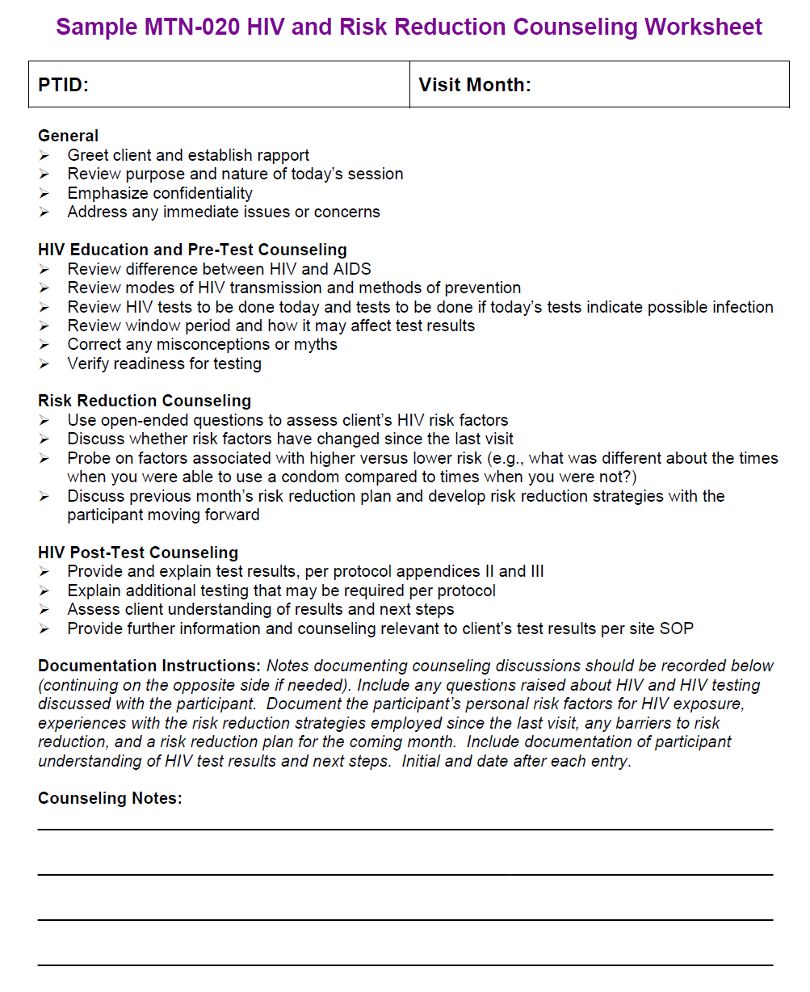
HIV and RR Counseling Documentation
Page 347
What information would be important to document?
Personal risk factors for HIV exposure
Barriers/Facilitators to RR
Experiences with the RR strategies employed since the last visit
RR plan for the coming month
Documentation of participant understanding of HIV test results and next steps
Notes:
Questions for the group: What are your thoughts on documentation of “standard” HIV education and pre-test information at each visit? Tie back in efficiency concept – checklists can be used.
Note that there are not separate worksheets – after each entry
What information would be important to document?
Key concept: enough information is needed so that counseling can be continuous/built over time, whether it is the same counselor or not. Don’t want to start from square one each and every time. Not only would this be slightly annoying to the participant, but also a lot of extra work on the counselors part and inefficient – counseling should build over time.
Page 347 in binder

Slide 5
Modified Procedures in the event of a HIV positive rapid test result

Slide 6
In the event of HIV (+) Rapid
On the same day of a positive rapid HIV test result(s):
Collect blood and send for Western Blot, HIV RNA, and CD4+ testing
Collect blood for plasma storage for confirmatory testing at NL.
Hold product: complete a Vaginal Ring Request Slip and Product Hold/Discontinuation Log CRF
Collect used VR for storage (LoA#2)
Counsel the participant regarding her HIV status per SSP Section 12 and site SOPs; provide referrals per site SOPs
Schedule to come back for WB result
Complete HIV Confirmatory Results CRF as results become available
Notes:
Handout = Section 6.5 from SSP
The following procedures must be done the same day of a positive rapid HIV test result(s) during follow-up:
-Collect blood and send for Western Blot, HIV RNA, and CD4+ testing. Record all results on a HIV Confirmatory Results CRF. The blood used for the Western Blot must be collected and labeled separately from the sample used for the HIV rapid tests.
-Collect blood for plasma storage for future HIV seroconversion confirmation testing. Document collection on Monthly Laboratory Results CRF.
-Complete a Vaginal Ring Request Slip and Product Hold/Discontinuation Log CRF to document the product hold.
-Counsel the participant regarding her HIV status per SSP Section 12 and site SOPs; provide referrals per site SOPs
Perform all of the procedures listed above even if a participant’s rapid test results are discordant.
For sites not doing finger stick for rapid HIV tests, the samples for Western Blot, HIV RNA, CD4+, and plasma storage are collected separately from the sample used for HIV rapid testing.
Provide rationale for sample and what to do in the instance a sample is missed

Slide 7
Monthly Laboratory Results (MLR-1) – p. 349
MLR collects HIV rapid test results and plasma storage for seroconversion confirmation
Specimen Storage CRF will document collection of used ring

Slide 8
Modified Procedures for Seroconverters
If HIV infection is confirmed:
Permanently discontinue study product
Communicate to Pharmacy via Vaginal Ring Request Slip
Document in database by updating and re-faxing Product Hold/Discontinuation Log CRF
Inform/counsel participant of her confirmed HIV-infection status. Refer per site SOPs.
Administer PUEV/Discontinuers ACASI (and complete Follow-up ACASI Tracking CRF)
Generate schedule for additional serconverter procedures (use Excel tool)
Notes:
This ACASI interview is administered at the time of product discontinuation and is not made up if missed. No further ACASI interviews will be administered for this participant.
ACASI can be administered at interim visit when WB results are provided, or at next scheduled visit.

Slide 9
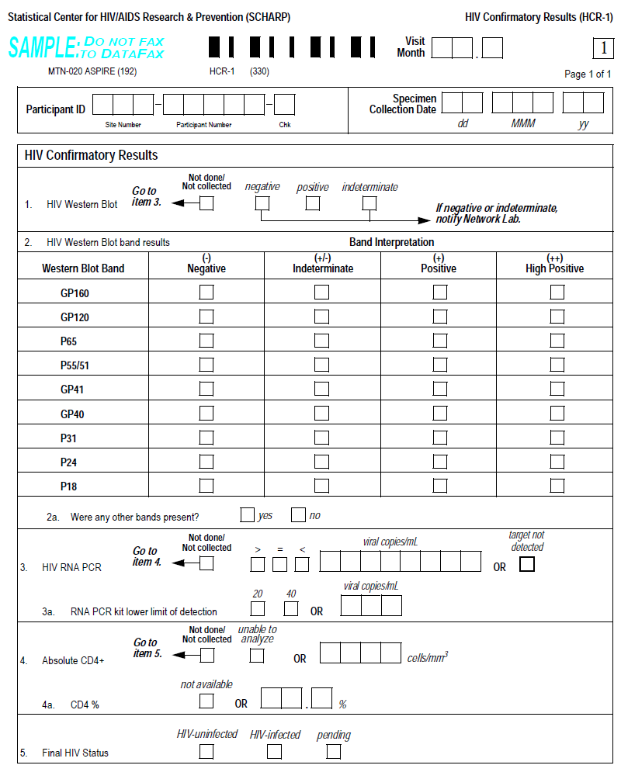
HIV Confirmatory Results CRF
Page 351

Slide 10
Modified Procedures for Seroconverters (Cont.)
Discontinue
Add
-HIV serology, HIV pre- and post-test counseling
-Provision of VR, instructions, adherence counseling
-CBC with platelets and blood chemistries
-Plasma storage and self-collection of vaginal fluid swab (note plasma still collected but on a different schedule)
-Will not complete Study Exit/Termination Visit (PUEV will be ppts last study required visit)
At 1, 3, 6, 12, 18, and 24 months following the visit with the positive rapid HIV test result:
- Seroconverter plasma storage
- CD4+ T cell count
- HIV-1 RNA PCR
Completion of Seroconverter Laboratory Results CRF
Discuss MTN-015 enrollment with participant
Notes:
Rationale for the bullets should be provided:
Discontinue blood tests (no need to monitor safety here due to no product use)
Discontinue plasma storage/self-collected swab (since these are adherence measures)
NOTE: plasma is still collected, but this is done on a different schedule now (for seroconverters- 1, 3, 6, 12, 18 etc)
No term visit (b/c purpose of this is to assess for delayed seroconversion)
Add the labs at 1, 3, 6,12, 18, 24 until participant enrolls in MTN-015 for monitoring HIV status (documented on SLR CRF)
Additional Samples = stop if she enrolls in 015
All procedures for MTN-020 will continue except for the following:
The following procedures will be added as part of the regularly-scheduled MTN-020 study visits occurring 1, 3, 6, 12, 18, and 24 months following the visit with the positive rapid HIV test result.

Slide 11
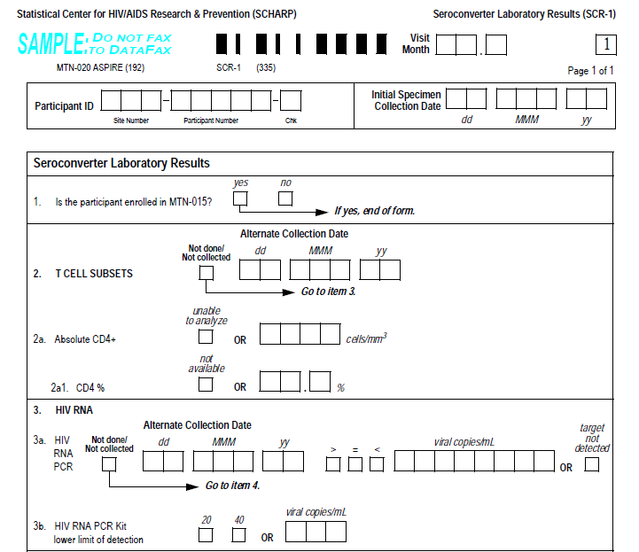
Seroconverter Lab Results CRF
Page 353
Completed at post seroconversion visits (Months 1, 3, 6, 12, 18, 24)
Completed even if ppt enrolls in MTN-015

Slide 12
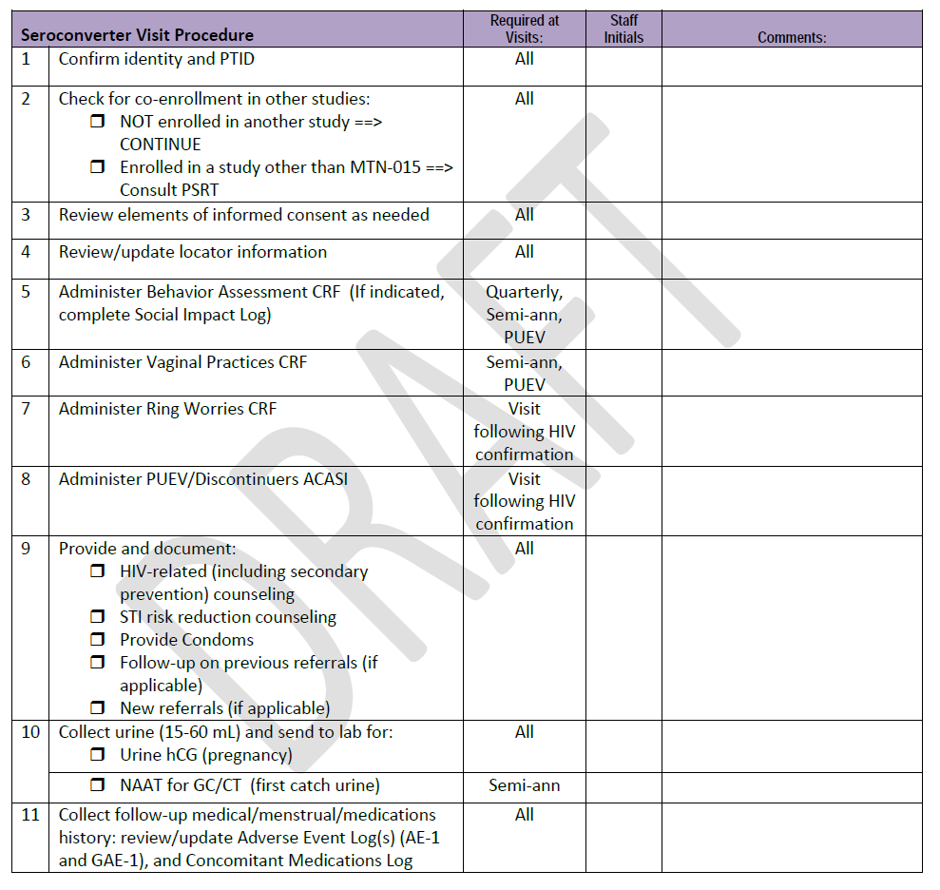
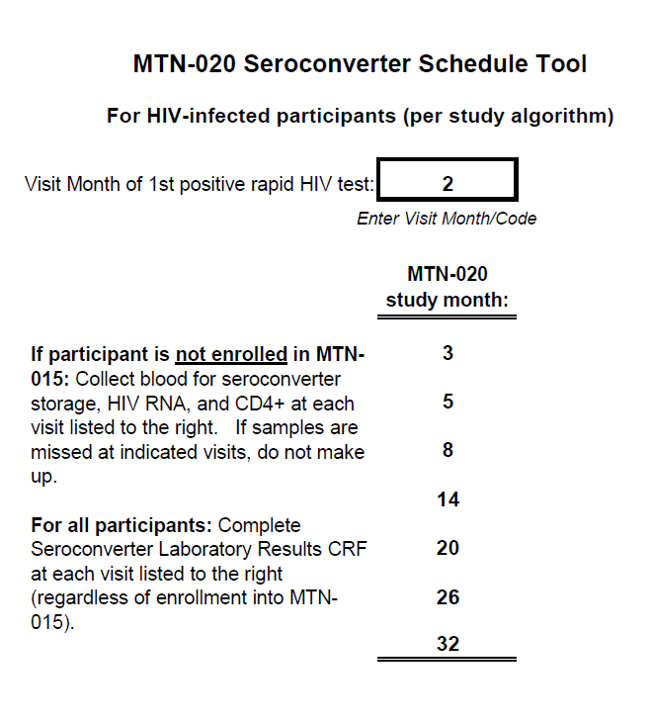
Seroconverter Tools
Page 355 & 359
[Screen shot calculator]
[Screen shot checklist]
If a specimens are missed at one of these visits, they are NOT collected at the next visit.
Notes:
Turn to tools in your notebook, discuss utility of each in tracking procedures for seroconverters
Visit windows for the collection of the seroconversion specimens are the same as the visit windows for the visit indicated. Samples should not be made up if missed.

Slide 13
Activity: HIV Counseling and Testing Scenarios
Notes:
Any questions before we start the scenarios?
Participants should get into small groups or partners, or just do together as a large group depending on time.

Slide 14
Scenario #1
A ppt has two positive HIV rapid test results at her Month 17 visit on 14-JUN-12.
What additional samples should be collected given the positive rapid test results? Is an additional blood draw needed? What CRFs related to HIV testing and study product need to be completed?
How would procedures change if only one HIV rapid test was positive?
What if sample collection for plasma for HIV confirmatory testing/CD4/HIVWB is missed during this visit?

Slide 15
Scenario #2
A ppt has two positive HIV rapid test results at her Month 17 visit on 14-JUN-12. The WB result is received on 20-JUN-12 and it is positive. The ppt is contacted to come in and receive her WB results and counseling. She comes to the clinic on 23-JUN-12 for this interim visit.
How is the HIV Confirmatory Results form completed? What other CRFs/forms are updated on June 20?
Besides counseling on her confirmatory results, are any other study procedures conducted on 23 June?
What procedures are no longer done for this participant from this point forward?
What additional procedures and related CRFs will be completed for this ppt from this point forward? Has this participant completed her PUEV?

Slide 16
Scenario #3
A participant had HIV positive rapids on Month 17, which was confirmed with a positive western blot.
At which time points/visits are the seroconverter specimens required to be collected (i.e. seroconverter plasma, HIV RNA viral load, CD4+ count)?
When the ppt comes in for Month 20 on August 6, she reports she enrolled in MTN-015 on July 28th. What procedures are modified for this visit?

Slide 17
Scenario #4
A ppt has discordant rapid HIV test results at her Month 18 visit on 02-SEP-12. A plasma specimen is stored for HIV seroconversion confirmation and WB, HIV RNA viral load, and CD4+ testing is done. The WB comes back negative.
What do you do?

